Slide 1

Lambda
Lambda functions
Intro to serverless computing

Slide 2
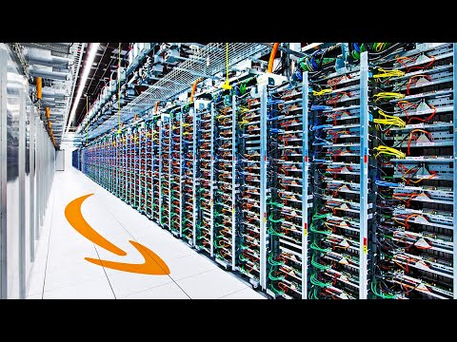
Execution continuum
EC2, EKS, ECS, Fargate
Elastic Beanstalk
API Gateway + Lambda
Lambda
Run any software you want for as long as you want
Complete control over HW and SW
Hardest to config
Upload .zip file
Limited software choices
Some control over HW and SW
Function based
Near-zero config
Web service + functions (15-min limit)
Function based
Near-zero config
Short execution (< 15 mins)

Slide 3
AWS lambda
By far the simplest, least expensive way to compute
EC2, EKS, ECS, Fargate
Elastic Beanstalk
API Gateway + Lambda
Lambda
function
Scalable! Each call executes independently on different HW => horizontal scaling
Notes:
Azure functions (Microsoft), Cloud functions (Google)

Slide 4
AWS lambda / Azure functions / Google functions
Standalone functions executed on demand
Can be written in JavaScript, Python, Java, C++, etc.
Execution time is limited (AWS => 15 minutes)
Callable in a variety of ways:
Like a traditional function( ) using AWS library
Based on events that occur (e.g. uploading an item into S3)
Via function URL through AWS-managed web server
Via API Gateway offering a more customizable AWS-managed web server (e.g. test vs. production, more authentication options, …)
Notes:
Why the short timeframe? AWS is trying to utilize idle hardware, and it's easy to manage and schedule if they know there's fixed time limt. Also, AWS would rather rent you machines for longer timeframes, so they limit lambda. It's completely arbitrary what the time limit is…

Slide 5








AWS lambda / Azure functions / Google functions
Standalone functions executed on demand
Can be written in JavaScript, Python, Java, C++, etc.
Execution time is limited (AWS => 15 minutes)
Callable in a variety of ways:
Like a traditional function( ) using AWS library
Based on events that occur (e.g. uploading an item into S3)
Via function URL through AWS-managed web server
Via API Gateway offering a more customizable AWS-managed web server (e.g. test vs. production, more authentication options, …)
Notes:
Why the short timeframe? AWS is trying to utilize idle hardware, and it's easy to manage and schedule if they know there's fixed time limt. Also, AWS would rather rent you machines for longer timeframes, so they limit lambda. It's completely arbitrary what the time limit is…

Slide 6
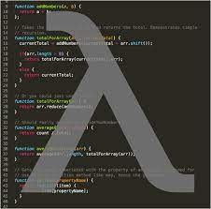
Example: prime factors in Python
https://2noicxltxjwxxt4ego5d7q4uc40bcgjw.lambda-url.us-east-2.on.aws/?n=600851475143
https://2noicxltxjwxxt4ego5d7q4uc40bcgjw.lambda-url.us-east-2.on.aws/?n=6008514751439999
import json
def prime_factors(n):
i = 2
factors = []
while i * i <= n:
if n % i:
i += 1
else:
n //= i
factors.append(i)
if n > 1:
factors.append(n)
return {
'statusCode': 200,
'body': json.dumps(factors)
}
Notes:
The 2nd URL takes 10-20 seconds. Take the time to show Lambda console in AWS, tail the log and show calls coming in, show test facility, etc

Slide 7
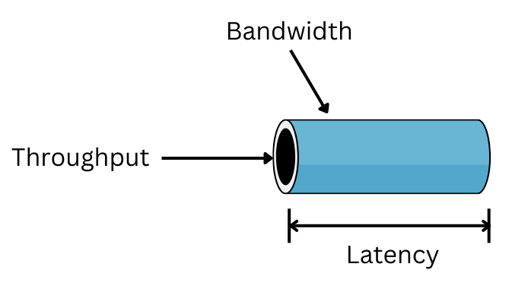
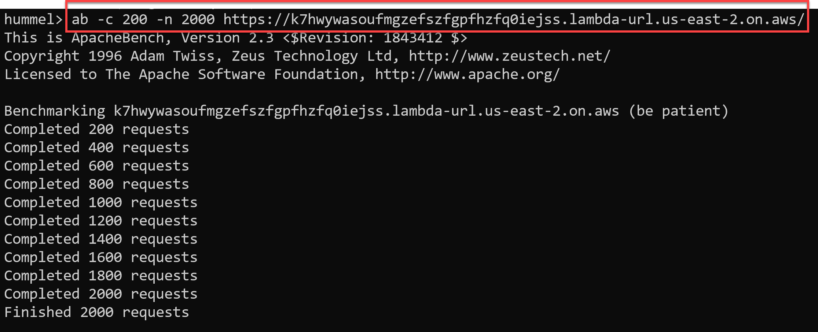
Latency vs. Throughput
Lambda trades latency for throughput
Lambda functions have a longer latency (i.e. slower)
Takes time to load function + support libraries
Lambda offers higher throughput (supports more clients) by automatically scaling calls across EC2
Notes:
Slower for one user: ab –c 1 –n 10 …
But scales with more users: ab –c 200 –n 2000 …
NOTE: run this on NU network, on home WiFi it doesn't scale like this (?)

Slide 8
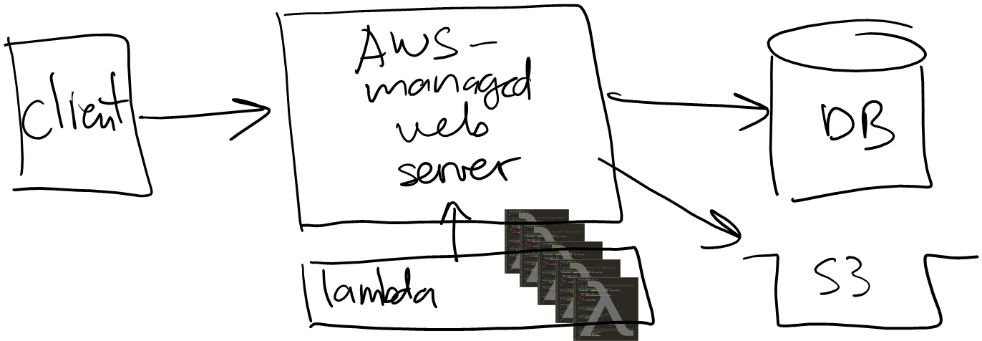
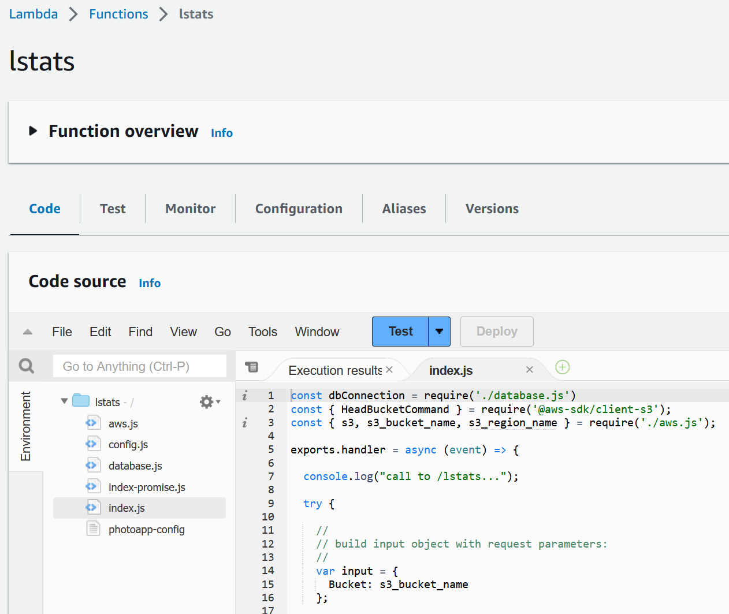
Demo #2: lambda-based stats
https://k7hwywasoufmgzefszfgpfhzfq0iejss.lambda-url.us-east-2.on.aws/
Let’s compare our project 02 web service /stats vs. a lambda-based version of /stats
Notes:
Execute via web browser, see that we get stats back but with "lambda" in the response

Slide 9
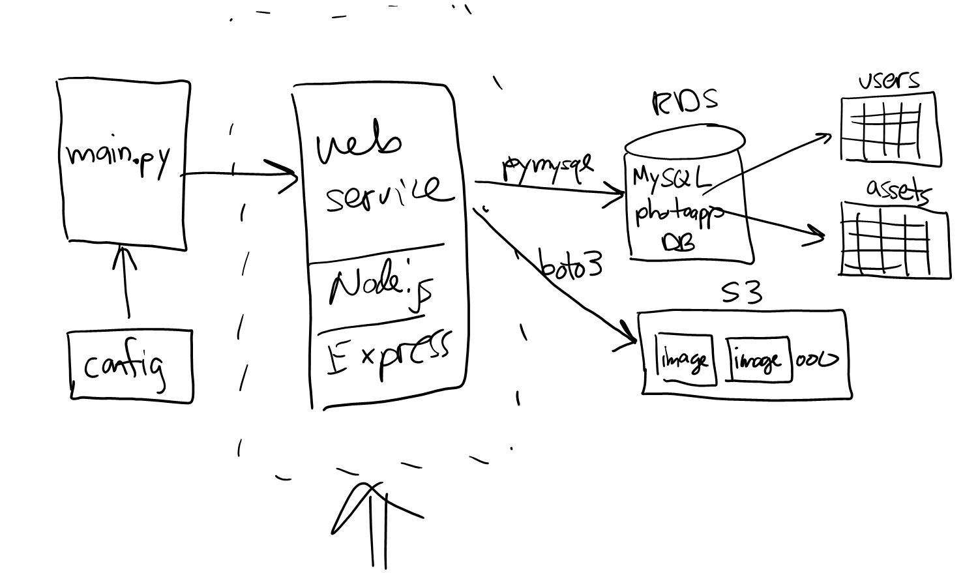
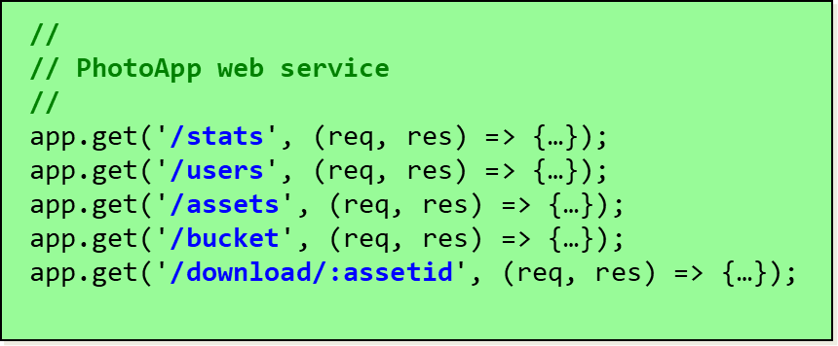
Serverless computing
Architects realized the web server is often just a "gateway" to the functions
Break the monolithic code base => functions or microservices…
… and let AWS manage the web server!

Slide 10









Serverless computing
Architects realized the web server is often just a "gateway" to the functions
Break the monolithic code base => functions or microservices…
… and let AWS manage the web server!

Slide 11
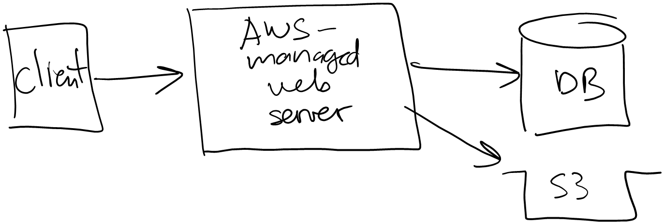

Serverless doesn't mean no server
We still have a web server…
We just don't manage it

Slide 12
That's it, thank you!

Slide 13
Lambda demo: add 2 numbers in Python
https://hajhq7qffcl4llhobulwfozqgq0lvngi.lambda-url.us-east-2.on.aws/?n1=10&n2=20
import json
def lambda_handler(event, context):
#number1 = int(event['n1'])
#number2 = int(event['n2'])
params = event["queryStringParameters"]
number1 = int(params["n1"])
number2 = int(params["n2"])
print(number1, '+', number2)
sum = number1 + number2
print("sum:", sum)
return {
"Number1": number1,
"Number2": number2,
"Sum": sum
}
Notes:
https://wm34gngmwqb3a7yacwoo3h477m0abcpk.lambda-url.us-east-2.on.aws/?n=600851475143
https://wm34gngmwqb3a7yacwoo3h477m0abcpk.lambda-url.us-east-2.on.aws/?n=6008514751439999 --- take about 10 seconds

Slide 14












Slide 15
app.get('/stats', (req, res) => {
s3_response = s3.send("HeadBucketCommand"));
rds_response = new Promise((…) => {
db.query(`Select count(*) from users; Select count(*) from assets;`);
});
Promise.all([s3_response, rds_response]).then(results => {
res.json(…);
}).catch(err => {
res.json(…);
});
});

Slide 16
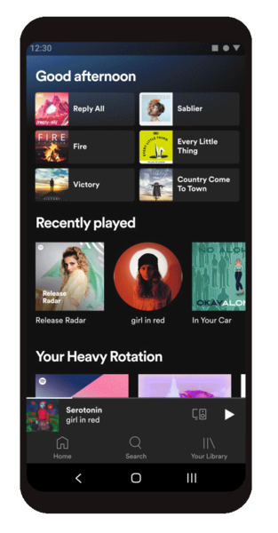












Slide 17

DB
DB

Slide 18

DB

